Slide 1
My First Colo
Background on bringing up a wholesale infrastructure.
https://github.com/cpc2018/my-first-colo
Originally authored by: Colin Corbett
Colin+dc@corbe.tt
This work is licensed under a Creative Commons Attribution 4.0 International License.
Notes:
Hello,
This is a presentation about building your first wholesale colocation facility.

Slide 2
What is a rack / What is a colo?
Notes:
So, lets start with the basics.
What is a rack? A rack, in this case, is a server cabinet, that can hold up to 42-52 Units of servers, that consume some amount of power, possibly beyond 20Kw. They are usually air cooled, with cold air coming in the front, and the hot air leaving out of the back. Usually 2 to 2 ½ feet wide 3 to 4 feet deep, and 6 ½ feet to 8 feet tall, and when loaded can weigh over 3000 lbs.
What is a Colo? Its short for colocation. It involves placing your equipment, usually in racks, in a datacenter.
In this case, we are talking about putting a large number of racks into a datacenter, and having them all interconnect, in a reliable, secure way.

Slide 3
Retail, vs. Wholesale, vs. Owned
Sizing | standard retail | premier (high retail) | wholesale | high wholesale | Owned/Build to suit
Brief description | (small, cheap) | (small, not cheap) | medium (cheap) | medium (not cheap) | large
space size | 0-250Kw | 0-250Kw | 250kw-6Mw | 250kw-6Mw | 2Mw-30Mw
# racks | 0-25 | 0-25 | 25-200 | 25-200 | 200-3000
power billing | Metered or allocated | Allocated | Metered | Metered | Metered
sq footage | up to 750 Sq ft. | up to 750 Sq ft. | up to 12k Sq ft | up to 12k Sq ft | up to 250K Sq ft
contract length | 2-3 yrs | 2-3 yrs | 5-7 yrs + renewals | 5-7 yrs + renewals | 10 yrs +
crossconnect billing | possible NRC / monthly | NRC + high monthly | possible NRC / monthly | NRC + high monthly | N/A
Peering fabrics available? | possible | definitely | possible | highly likely | unlikely
Backhaul needed? | likely | n/a - most on-site | likely | possible | likely
dedicated office | unlikely | unlikely | likely | likely | yes
dedicated storage? | unlikely | unlikely | likely | likely | yes
# Carriers | 1 to 5 | 20+ | 1 to 5 | 5 to 20 | 1 to 5
security 24x7 | likely | expected | likely | expected | expected
engineering 24x7 | possible | expected | possible | likely | expected
broker needed | no | no | recommended | recommended | recommended
lease style | monthly contract | monthly contract | triple net or modified gross | triple net or modified gross | N/A or 3 N
estimate time to go live | 60-150 days | 60-150 days | 120-210 days | 120-210 days | ~1yr +
Notes:
Datacenters can be broken down into 3 general categories of Retail, Wholesale, and Owned, with a couple of variants.
In a retail datacenter, (in blue) this is a 1-25 rack installation, that is usually a contract of ~2-3 years. This is usually seen as a starter location, or as a expensive connectivity hub, where you can interconnect directly with up to hundreds of networks.
In a wholesale datacenter, (in green) these generally fit in the 25 to 400 rack installs, with a contract that is usually 5-7 years. These are usually for ongoing growth of infrastructure, and you might be growing into these gradually.
In an owned or Build to suit datacenter, (yellow) these can be very large facilities. Here, you may be responsible for the entire building, meaning things like the cooling plant, the electrical infrastructure, and the general maintenance etc. At this scale you may have hundreds of thousands of servers.
In all cases, hardware in here is usually refreshed on a 3 year cycle.

Slide 4
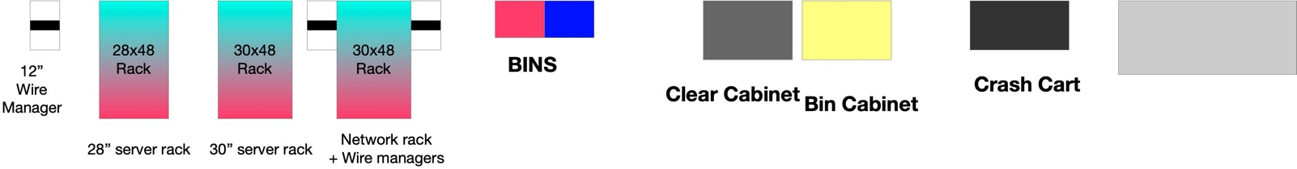
Sample Space Layout – 1 Mw
Notes:
So, as we walk through a 100 Rack(ish) deployment, this would be a standard site layout.
We’d have rows of servers, a row of networking gear, room for spares and tools, etc.
This is a sample layout of how things could be done in a 1 MW layout.
Server racks are iterative building blocks, and the network can be too.

Slide 5
The teams
Datacenter Lawyer
Executive Sponsor
Datacenter Broker
Rack Integrator
Networking Reseller
Datacenter / Network Architect
Finance/Procurement Team
Project Management
Systems/SRE Team
Network Team
Security Team
Datacenter Team
Monitoring / Tools Team
Capacity Planning
Electrical Company
Low Voltage Cabling company
Notes:
In looking to bring up a facility, there are a lot of teams that are needed, and they all work together to bring the site live.
The lawyer Is put first, as it is considered this the most important role. Lots of things can go sideways, and having a flexible contract, makes a huge difference.
But, this is truly a team effort. The more in sync they are, the quicker things will go.

Slide 6
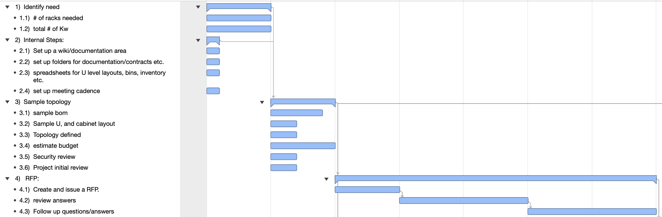
The Project Plan (fast) (early phases)
Notes:
Here is an example of the early steps of a aggressive project plan for selecting a datacenter.
We would identify a need for a datacenter, determine how many racks, and Kw we would need, and the market we would want it in.
From there, its set up a lot of infrastructure for documentation. We will need to refer back to this extensively.
After that, its work together, to do sample layouts of the datacenter, servers, network infrastructure. We would then get a sample topology, a security review, and an estimated budget.
Then we issue an RFP to the appropriate datacenter players. Then, its comb through the responses, and whittle the locations down. After that, we would do extensive diligence of visiting the locations, reviewing their processes etc.

Slide 7
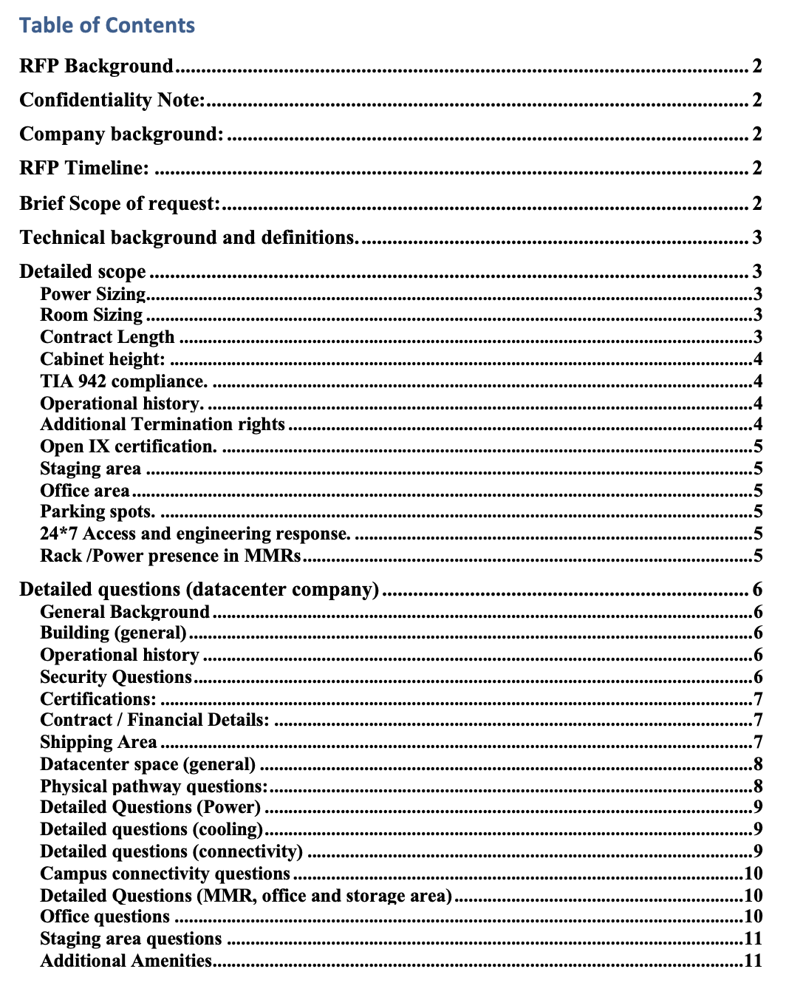
Site selection
RFP
Site Visits
Process review
“Tier 3”
Notes:
Here is an example of some of the RFP process (this is the table of contents off of the sample RFP), and the datacenter visit checklist. Try to get a lot of the questions about a facility sorted out in detail in the beginning, and then visit in person and make sure to see all of the different aspects of the facility.
A quick side note. Most datacenters fall on a “Tier” system of 1-4, which is defined by the Telecom Industry Association. A Tier 3, is defined as “Concurrently Maintainble”, which means that anything can fail, and the site keeps running. Tier 4 is the highest.
However, to be Tier 3, a site must be Tier 3 Electrically, Mechanically (Cooling), and Architecturally. A lot of sites meet the Electrical and Mechanical, but fall short in the Architectural. Since sites self-certify their compliance, extensive inspection is usually needed to uncover concerns.

Slide 8
Datacenter Local Connectivity examples
Notes:
After you have selected a site, you will then want to understand your connectivity plans.
Depending upon your needs, and what is available in the facility you select, may need to connect your building to a Well Connected building, also known as a peering hub.
This can be for things like getting access to a cloud provider, such as a AWS Direct Connect or a GCP Dedicated interconnect connecting or with various eyeball and research networks.
Also, you can connect to various peering fabrics, allowing you to have a direct routing relationship with hundreds of networks.
You will also be able to connect to various transit providers as well.

Slide 9
Worldwide Connectivity
Where do you expand?
Interconnection points, space availability, regulation considerations
Partner networks
Undersea cable
Tier 1 markets US
Ashburn, VA
Bay Area, CA
LA, CA
NY, NY
Chicago, IL,
DFW, TX
Tier 1 markets EMEA
Frankfurt, DE
London, UK
Amsterdam, NL
Paris, FR
Tier 1 markets AP
Tokyo, JP
Singapore, SG
Hong Kong, HK *
Tier 2 markets AU
Melbourne
Sydney
Perth
Tier 2 markets US
Seattle, WA
Miami, FL
Atlanta, GA
Toronto, CA
Portland, OR
Houston, TX
Phoenix, AZ
Las Vegas, NV
Tier 2 markets AP
Seoul, KR
Taipei, TW
Osaka, JP
Tier 2 markets S.A.
Sao Paolo, BR
Rio De Janeiro, BR
Bogota,
Tier 2 markets AP
Seoul, KR
Taipei, TW
Osaka, JP
Guam **
Tier 2 markets EMEA
Stockholm, SE
Prague, CZ
Helsinki, FI
Marseille, FR
Tier 2 markets Africa
Johannesburg, SA
Capetown, SA
Notes:
As you start to expand globally, a lot of selection will be based upon the nearby peering hubs. This is not just for speed, but for minimizing overall latency, and increasing choices for traffic egress.
Here are a list, of some of the Tier 1, and Tier 2 markets in the world. This is not an exhaustive list, and some of the markets could be considered in different tiers.
Hong Kong and Guam, are very interesting at the moment, mainly due to the political changes going on in HK. A lot of undersea cable went through HK. There are now a lot of new undersea cables being run with Guam and Taipei being replacement undersea points.

Slide 10
The Cookie Cutter approach.
Notes:
So, heres an example of what has worked for various places.
Use a very cookie cutter approach.
Try to lock hardware and architecture in for anywhere for 6-12 months per location type.
Work with integrators, and datacenter vendors, to have 1-2 quarters of growth planned out.
Have hardware ready to arrive on a standard cadence, with some spare capacity held back.
This way, you have space, power and cooling ready to support growth.
Try to build things of the same version identical to each other. Document the differences between versions.
This allows for the team to be able to grow infrastructure in a reliable fashion, and saves the need for heroics.

Slide 11
Questions?

Slide 12
Backup slides

Slide 13
Spares Needed
Notes:
There is the old parable of “for want of a nail”.
I have seen deployments lose days of productivity, due to a $5 part that wasn’t ordered.
I’ve seen people pay 10X the cost for items, because they needed it now and it wasn’t there via normal channels on time.
I’ve sat in the cold of Chicago in December, waiting for parts that were critical, but were not ordered waiting for a Saturday delivery by fedex.
I view none of this as acceptable.
With appropriate planning and sparing, this decreases downtime, as needed parts are on-hand, to restore service, or to maintain hardware. It also gives you a margin for error.
I have an approach to sparing that tries to make sure we have the ability to endure failures, restore functionality and keep the site running.
Things will fail. Servers Crash, Routers reload. Optics die. Through planning, policies, documentation and sparing, we can minimize the impact, and make sure that failure does not lead to downtime.

Slide 14
Previous problems/Anecdotes.
20 providers (but 0)
24x7 engineering (but ~0)
No loading dock
Notes:
A few quick finishing andecdotes of problems that have occurred
When a company signed a contract for a datacenter, The datacenter advertised that there were 20 carriers in the building. This was true, but on the floor we were on, there were 0 carriers. To get to the other carriers, they wanted 18K / month extra. This is one of the reasons we should always insist on asking detailed questions, and visiting in person. Specificity is key.
Another time, in looking at a facility to take down 200 racks of space. They said they had 24x7 engineering onsite, but it was really that they had 1 graveyard shift engineer, for 11 buildings, spanning a square mile, who usually had an extensive list of maintenance tasks. They were on-site in only a very loose definition.
As a last example, some of the facilities that are out there, are historic. Some going back 100 years. While you may have to be in that facility from a connectivity standpoint, you may be moving into a location that has no loading dock, and you are unloading in the street, or have to shut down a street, or even having to load in via a crane. Understanding all of this, in advance, especially in a foreign country, makes for a smoother install.

Slide 15
What’s next
Notes:
Theres a lot of interesting stuff out on the horizon:
In the networking world; 400 Gig, 800 Gig.
Overlays, segment routing
DPUs in the server (eg: bluefield2/3)
PCIe5
GPUs and OAM connectors.
Different cooling solutions.
And so much more

Slide 16
Power / Cooling
Notes:
When running a datacenter, you will pay ~10-40% above your standard electrical load, to manage your cooling load. This is called PUE, or Per Unit Efficiency.
There are a lot of innovations going on with things like power density and cooling.
However, there are a lot of tradeoffs.
On the cooling standpoint, there are now things like:
Rear door cooling, to help move air through a rack.
Sometimes these rear doors have radiators attached to them, so that most of the heat load is transferred to liquid at the back of the cabinet and carried away there.
There are also things like on-chip cooling, all the way to immersion cooling, where the equipment is run submerged.
However this brings up interesting issues:
The liquid can cost between $200-500 a gallon.
Sometimes you look at doing single or dual stage cooling, which means you need to condense it back down.
Your technicians need to be trained with how to handle chemical spills.
But, at a certain scale the cost savings of the reduced cooling could make sense.
Most datacenters are still practicing air cooling only, and may not be receptive to that.
Another note is that there are various initiatives such as opencompute that are starting to make interesting innovations.

